Slide 1
E-Commerce Data Analysis (By: Brandon McManus)

Slide 2
Data Set Information:
Transnational data set which contains all the transactions between 01.12.2010 – 09.12.2011 for a UK-based and registered non-store online retail
*Company sells unique all-occasion gifts
*The majority of the customers are wholesalers

Slide 3
Attribute Information:
InvoiceNo (Invoice Number): 6-digit integral number uniquely assigned to each transaction. (if InvoiceNo starts with c, it means cancellation)
StockCode (Product Code): 5-digit integral number uniquely assigned to each different product.
Description (Product Name)
Quantity: quantities of each product per transaction
InvoiceDate: day and time when each transaction was generated
UnitPrice: product price per unit
CustomerID: 5-digit integral number uniquely assigned to each customer
Country: name of the country where each customer resides

Slide 4
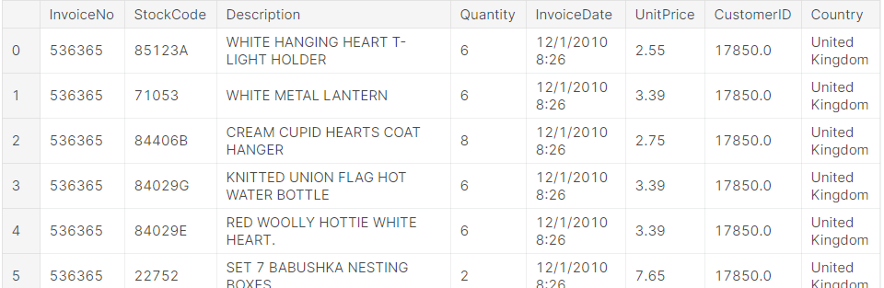
Data Exploration & Data Cleaning
541908 entries

Slide 5
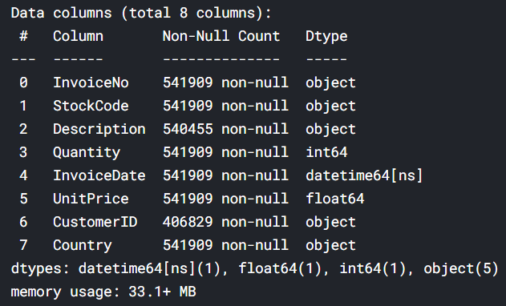
Data Exploration & Data Cleaning
Change InvoiceDate from object Dtype to datetime64
Change CustomerID from float64 Dtype to object

Slide 6
Data Exploration & Data Cleaning
Any missing values? Yes.
There are almost 25% (135080) of the CustomerID column missing and less than 1% (1454) of the Description column missing.
Check to see if the rows with missing Description values are also missing CustomerID values in order to eliminate unnecessary work.

Slide 7
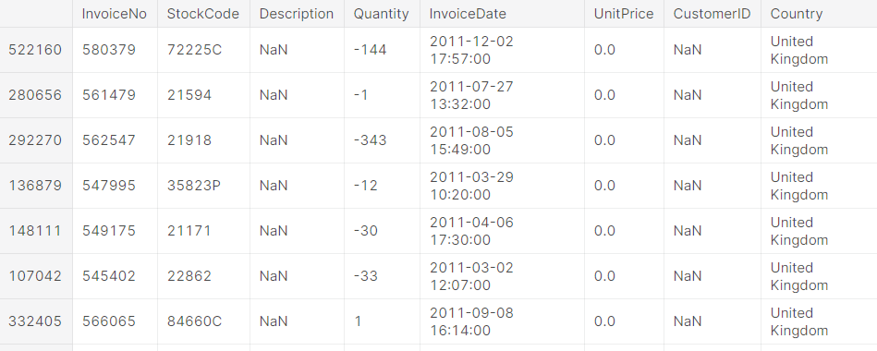
Data Exploration & Data Cleaning
All the missing values for the Description column are also missing CustomerID values and for every row the UnitPrice is 0 and the Quantity is either positive or negative
Drop all transactions with missing Descriptions, with UnitPrice=0 and missing CustomerID in order to make accurate insights for this data analysis

Slide 8
Data Exploration & Data Cleaning
How many transaction cancellation do we have? (cancelled transaction = InvoiceNo starts with “C”) 2,18%.
Drop these values too in order to make accurate predictions.

Slide 9
Stock Codes and Descriptions
There are 3665 unique StockCodes and 3877 unique Descriptions which means that the retailer sells many different types of products.
Looking at the most common StockCodes and descriptions being sold we can notice that our top 20 most frequent StockCodes and descriptions match up with eachother in terms of level of frequency.

Slide 10
Customers and Countries
What customers and what countries had the most transactions?
Thus, we realised the correlation between the top customers and countries and we saw that the majority of transactions take place in UK. It appears that we have a few outliers in our top customers group where the top country is Ireland and the Netherlands. However, the majority are from the United Kingdom.

Slide 11
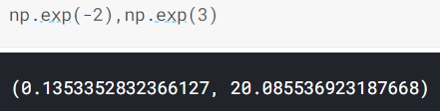
Unit Price and Quantity
In order to proceed with the time-series analysis, we graphed the distribution for the Unit Prices and saw that a lot of prices are quite small and there are a few outliers that are very large.
Because of the high frequency of small transactions we focused on the transactions with prices in the log-unit-price graph. (the majority of the prices are between -2 and 3 => exponent of -2 and exponent of 3)
Thus, the majority of our distribution lies between 0.1 and 20.1 so we deleted all the outliers outside this range

Slide 12
Unit Price and Quantity
For the graph of the Quantity Column we can notice that we have a small amount of outliers greater than 70000. It looks like we will be able to keep more than 95% of our data with a max quantity set at 55.

Slide 13
Time-Series Analysis
Which months had the highest Revenue?
We created new columns that represent different date ranges that we can use. We also created a revenue column in order to determine sales performance in different time ranges.
After analysing the outputs we saw that November is the highest revenue month for the company followed by October and then September. This could be because these are the months leading up to the holiday months where it is more likely people will be buying gifts and business increasing their inventory.

Slide 14
Time-Series Analysis
What product contributed the most to revenue? Why?
StockCode 22423 contributed the most to revenue by over $60000. Going deeper into details we find out that it has a higher Unit Price than the rest of the products. And this allows it to generate more revenue in lower quantities being sold.

Slide 15
Bibliography
https://www.kaggle.com/brandonmcmanus/e-commerce-data-analysis

